Slide 1
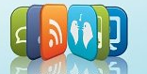
Evaluating Your Organization’s Social Media
February, 2012

Slide 2
Unit 1 About this Course

Slide 3
Seminar Objectives
By the end of this seminar, you will have had an opportunity to:
Develop an understanding what is meant by social media, the full spectrum of opportunities, and how companies use this new tool
Develop an understanding of what makes up good social media strategies, governance, and policies.
Identify the risks in various aspects of social media
Identify the elements of an audit over an organization’s social media activities

Slide 4
Seminar Topics
The following topics will be covered during the seminar:
Social Media Defined
Social Media Strategies
Governance Over Social Media Activities
Monitoring the Conversation and Measuring Success
Social Media Risks
The Social Media Audit Program

Slide 5
Unit 2 Social Media Defined

Slide 6
How would you define social media?

Slide 7
Social Media Definitions
The online forms of communicating to the masses which include blogs, microblogs, social networking sites, and podcasts (Answer.com)
Social media is the new term for socializing online. It allows people to freely interact with each other online whenever and wherever they want. (CubixDev)
An umbrella term that defines the various activities that integrate technology, social interaction, and the construction of words and pictures. (iContact)
Social media is technically a means for social interaction through the web. (Online Schools)
Social media are media for social interaction, using highly accessible and scalable publishing techniques. (Wikipedia)

Slide 8
Our Working Definition
A Set of web-based broadcast technologies that enable the democratization of content, giving people the ability to emerge from consumers of content to publishers.

Slide 9
Social Media is Conversation
The number one risk is to your brand

Slide 10
Web 2.0
Originally coined in 2004
Not an update to technical specifications
Changes in the way developers and end-users use the web
Associated with web applications that facilitate interactive info sharing, interoperability, user-centered design, and collaboration

Slide 11
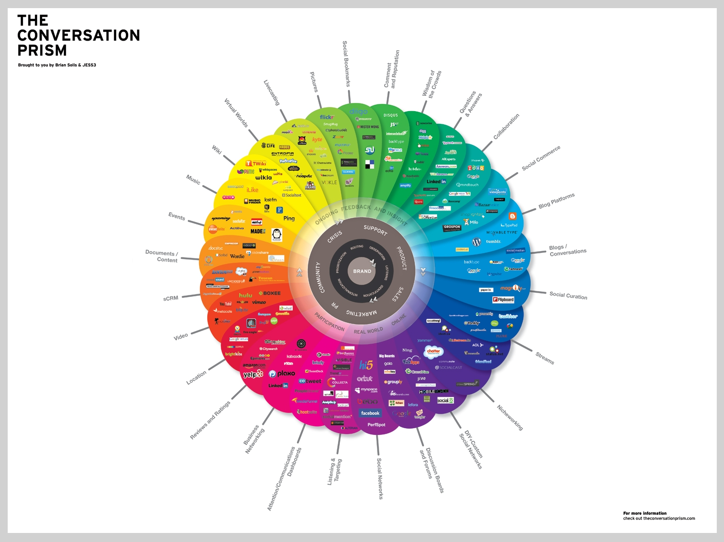
Web 2.0 Visualized

Slide 12
Using Social Media
How does your organization use social media?

Slide 13
What Might Go Wrong
How might the issues identified apply to your organization’s use of social media?

Slide 14
Unit 3 Strategies for Social Media

Slide 15
Scenario Activity: Evaluating Social Media Strategies
Read all three scenarios
Analyze each to determine why it represents an incomplete social media strategy
Determine what steps might be taken

Slide 16
Activity Summary
Incomplete Social Media Strategies
Ignoring Social Media
Assuming Non-Participation Needs No Further Strategy
No Overarching Strategy
Converted strategies are sufficient

Slide 17
Defining Strategy
“What is our business, who is our customer, what is our value to our customer, what will our business be, and what should it be?”
“Analytical thinking & commitment of resources to action and innovation. Making decisions today about an uncertain future. Taking the right risks while exploring opportunities”
- Peter Drucker

Slide 18
Traits of a Good Strategy
Focuses on Strategy, not tactics
Promotes a unique value proposition
Addresses real customer needs
Has a 3-5 year outlook
Lays the groundwork for implementation
Is appropriately documented

Slide 19
Specific to Social Media
Aligns with business objectives
Incorporated in other strategies
Identify target market and how each uses social media

Slide 20
Who Uses Social Media?
Seven categories of participation in social media - not exclusive and people may participate in more than one category at any given time.
Creators - People who publish blogs, develop images, create video content, host podcasts, etc.
Conversationalists - People who provide status updates in sites like Twitter
Critics - People who provide reviews and comments on blogs and forums
Lee & Bernoff - 2007

Slide 21
Who Uses Social Media?
Collectors - People who vote on and tag articles and other content
Joiners - People who join larger social networking sites such as Facebook and LinkedIn and create profiles
Spectators - People who are more passive, but enjoy reading, watching, and listening to social media that has been developed by creators, conversationalists, and critics.
Inactives - People who do not participate in any form of social media
Lee & Bernoff - 2007

Slide 22
Activity: Identify the Customer
For each person described in your workbook, determine which type of participant he or she is, and what strategy might focus on that type of individual

Slide 23
Contents of the Social Media Plan
Goals and Objectives
Channels
Engagement
Staffing and Funding
Metrics

Slide 24
Key Objectives Supported by Social Media
Increasing revenue
Improving customer satisfaction and loyalty
Recruiting and retaining the best talent
Product development and innovation
Enhancing brand awareness and perception

Slide 25
Unit 4 Governance and Social Media

Slide 26
Governance Frameworks – COSO Control and Risk Frameworks

Slide 27
GRC - Governance, Risk, and Compliance
Governance: The systems and processes by which the organization is directed, controlled, and held to account
Risk Management: The culture, processes, and structures that are directed to the effective management of potential opportunities and adverse effects
Compliance: The systems and processes that ensure conformity with business rules, policy and legislation

Slide 28
The Role of the Board
Provides broad oversight on all strategic decisions – including social media
Should understand why decisions were made and the related risks
Education on social media will be necessary
Updated as appropriate

Slide 29
The Role of Executive Oversight
Projects are advancing as expected
Continued alignment with overall strategies and objectives
Significant issues are brought to executives’ attention
Overall objectives are being met
Evidence of inadequate oversight
The “wrong” executive is in charge
An executive in charge who does not believe or does not understand
No communication at the executive level

Slide 30
The Role of Oversight Committees
Keys to Successful Social Media Committees
Committee makeup/department feedback
Knowledge of the unique situation
Roles and responsibilities
Objectives
Requirements of social media
Task definitions
Measures of Success
Prioritization
Issue Elevation
Statement of direction

Slide 31
Governance – Case Study
Provide an analysis of the current Governance Structure of Jump In ‘n’ Swim, Inc.

Slide 32
Social Media Policies – Internal
Clear communications on what employees can and cannot do on social networks
Specific restrictions regarding use of social media for non-work related activities
Considerations for all social media communications
Add value
Conversational style
Honesty and respect
Transparency and disclosure
Confidentiality
Ownership and registering properties
Endorsements and recommendations
Degree of personal and professional use

Slide 33
Social Media Policies – Internal
The organization’s monitoring practices
An outline of other policies that may be impacted by social media
Guidance on Conflicts of Interest Issues
IT requirements related to UserIds and passwords
Guidance on responding to comments
Guidance for crisis communication
Requirements that all applicable laws will be followed
Consequences

Slide 34
Social Media Policies – External
External social media policies should include:
Commenting allowed and disallowed
Comment moderation
Offensive language
Attacks and threats
Off topic
Proprietary information
Banning

Slide 35
Social Media Policies – External
Proactive and reactive management
Social media account disclosure
Service-level agreements
Hours of operation and response time
Error correction
What the organization will disclose and comment on

Slide 36
Unit 5 Monitoring the Conversation and Measuring Success

Slide 37
Monitoring the Conversation
Conversations Will Occur
Monitoring is Key
Monitor Even Where You Are Not Leading the Conversation
The Risk of Not Paying Attention
Good Monitoring Requirements

Slide 38
Listening
What are the attributes of good listening?

Slide 39
Listening
Basic Listening
Covers the organization, its stakeholders, the competition, and the industry
Best used when just starting
Used where there are limited resources
Advanced Listening
Takes place in more mature social media situations
Organization has developed a formal strategy or identified business objectives
More sophisticated tools
Runs concurrently with basic listening
“Where would a granular understanding of stakeholders have the greatest impact?”

Slide 40
Monitoring Continued
Listening
Learning
Responding
Measuring
Sharing

Slide 41
When Good Conversations Go Bad
As we read through the following transcript we will discuss the following questions:
Where did the conversation break down?
Where were the elements of good monitoring violated?
How should they have been applied, and what elements should be applied going forward?

Slide 42
When Good Conversations Go Bad
Nestle: To repeat: we welcome your comments, but please don’t post using an altered version of any of our logos as your profile pic – they will be deleted
PG: Hmm, this comment is a bit “Big Brotherish” isn’t it? I’ll have whatever I like as my log pic thanks! And if it’s altered, it’s no longer your logo is it!
Nestle: That’s a new understanding of intellectual property rights. We’ll muse on that. You can have what you like as your profile picture. But if it’s an altered version of any of our logos, we’ll remove it from this page
PG: Not sure you’re going to win friends in the social media space with this sort of dogmatic approach. I understand that you’re on your back-foot due to various issues not excluding Palm Oil but Social Media is about embracing your market, engaging and having a conversation rather than preaching! Read www.cluetrain.com and rethink
Nestle: Thanks for the lesson in manners. Consider yourself embraced. But it’s our page, we set the rules, it was ever thus.

Slide 43
When Good Conversations Go Bad
DS: Freedom of speech and expression
Nestle: You have freedom of speech and expression. Here, there are some rules we set. As in almost any other forum. It’s to keep things clear.
PG: Your page, your rules, true, and you just lost a customer, won the battle and lost the war! Happy?
Nestle: Oh please…it’s like we’re censoring everything to allow only positive comments.
DS: Honey you need new PR
JB: It’s not ok for people to use altered versions of your logos, but it’s ok for you to alter the face of Indonesian rainforests? Wow!
JG: I was a big fan of your products, but not now, when I saw what you guys wrote, I think I’m gonna stop buying them

Slide 44
When Good Conversations Go Bad
MK: Your attitude as a corporate representative is a disgrace!
HC: I’d like to know if the person writing the comments for nestle, actually has the backing from Nestle? I doubt it. Even a dumb ass company like them would get such an idiot to be their public voice.
Nestle: I think you missed out the ‘not’ there, Helen
HC: Yes well I’m lacking in the first morning NOT NESTLE coffee. I think you missed your manners in your comments.
MK: I’m not sure why you dislike the molding of your kitkat logo into “killer” I personally think it’s quite catchy
Nestle: Matt, you could start here: http//marketing.about.com/cs/brandmktg/a/watisbranding.htm

Slide 45
When Good Conversations Go Bad
HC: Well, that about sums you up. I just think Nestle would deal with public relations in a more professional manner. So while it’s fun arguing the toss with you on here, and it works well as publicity for our cause, the messages don’t actually get to Nestle
HZ: Is a nestle rep running this page?????
Nestle: We welcome debate – from any opinion. It helps us to know what people think and feel.
TR: “So, let’s see, we have to be well-mannered all the time but it’s perfectly acceptable to refer to us as everything from idiots right the way down to sons of satan with a few obscenities and strange sexual practices thrown in?” Actually, yes – strange though it may sound to you. As someone earlier said – you need to read the Cluetrain Manifesto to find out why – social media 101…
FS: I’m not using your logo…You deleted my comment anyway…

Slide 46
When Good Conversations Go Bad
AB: I have already PDF’d the page. Twitter is going off about this conversation mainly because the curator is so rude.
NP: ‘It’s our page, we set the rules, it was ever thus.” LOL. Thanks for the object lesson on how to suck at Web2.0. Bravo.
AG: Hey Nestle, this is the internet you *****…ALL YOUR BASE BELONG TO US
RA: You know Nestle…in the latest marketing week they even talk about turning negative press into something positive, eg. M&S ‘we booboo’d’ campaign and the ultimate example of skoda. I think you’re kind of missing the point of social media here.

Slide 47
When Good Conversations Go Bad
DD: What a total train wreck. Sorry Nestle, but you really don’t seem to get it do you? Social media provides you with an opportunity to engage with your customers – to listen to them, to show that you actually care about ethical issues in business. Sadly it seems you have precisely the opposite attitude and seem determined to be as aggressive, patronising and corporatist as you can. And practically guaranteed that folks will now start shunning your products.
BT: This is such a great case study of how not to do social media – all companies thinking of jumping on the social media bandwagon without considering the type of public conversations people are dying to have about your brand be warned!
CB: As someone who runs Facebook pages for brands I was astonished by the approach of Nestle in this instance. Surely Nestle know you don’t get into a dispute such as this in a public forum? If a customer has your logo on display you should be delighted at the fact that they are embracing your brand. The divisive attitude from Nestle is also bizarre…I think the Nestle press office should be made aware of this. If these posts have the buy in of the press office…o dear

Slide 48
Measuring – Value-Added Metrics
Value-adding metrics are those that show an activity is successfully helping the organization achieve its objectives.
“We have successfully achieved our objective of having one million followers on Facebook!”
“There have been 60,000 page views on our new website!!”
“Our most recent Tweet on new product development was retweeted by half our followers!!!”
“We have obtained 75 applications through LinkedIn!!!!”

Slide 49
Activity: Building Value-Added Metrics
What are the objectives for your organization?
What are the metrics used for your department?
How might these be aligned more strongly?

Slide 50
Social Media Metrics – What is it We Want to Measure?
Brand Recognition and Awareness
Customer Service
Human Resources
Innovation
Sales and Marketing

Slide 51
Unit 6 Social Media Risks

Slide 52
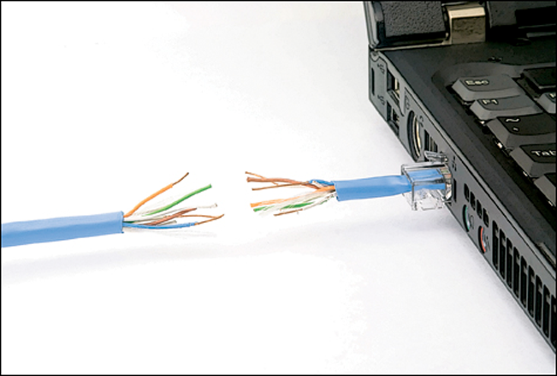
This can create a major disconnect

Slide 53

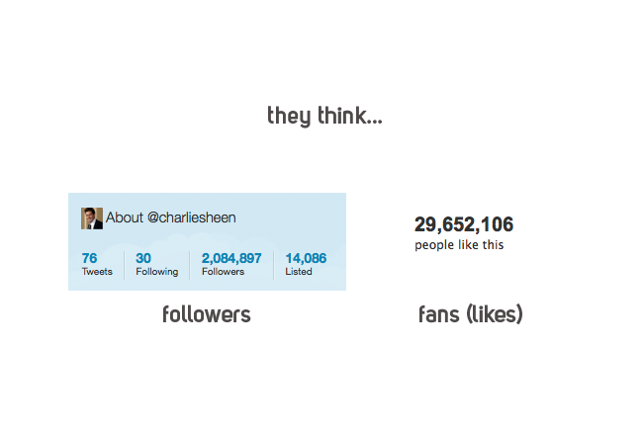

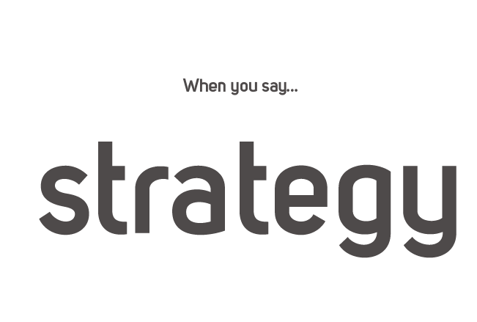


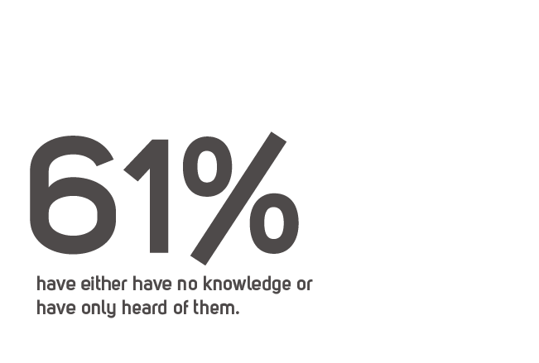

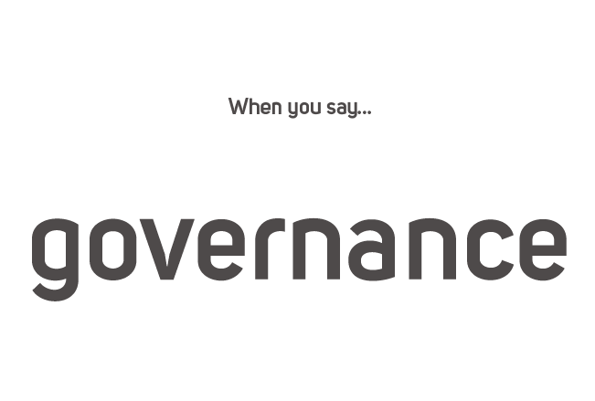

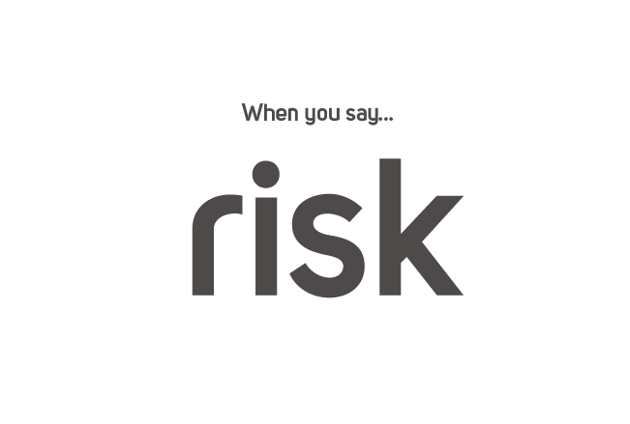


Slide 54
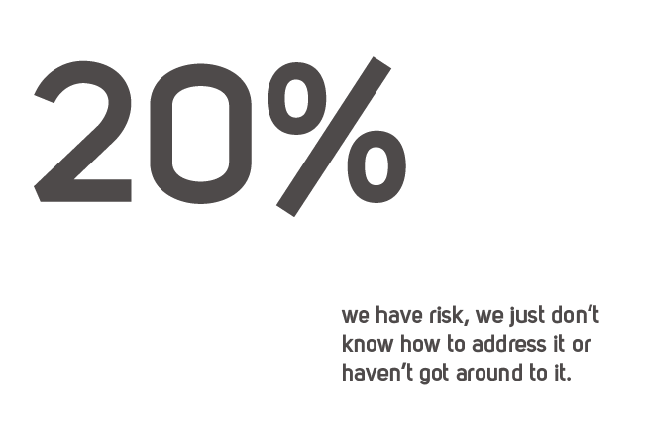
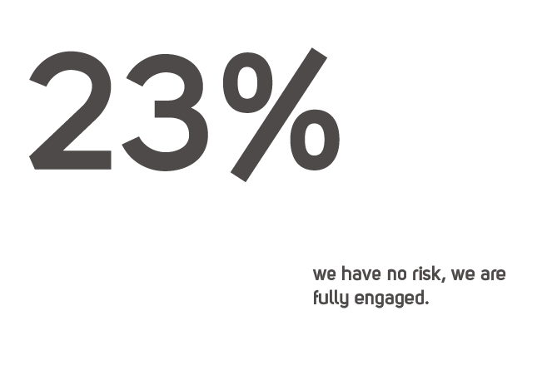
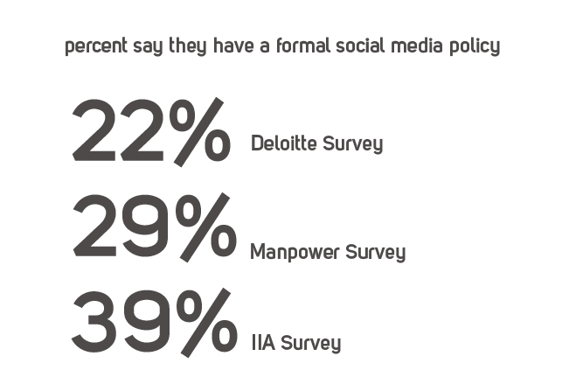
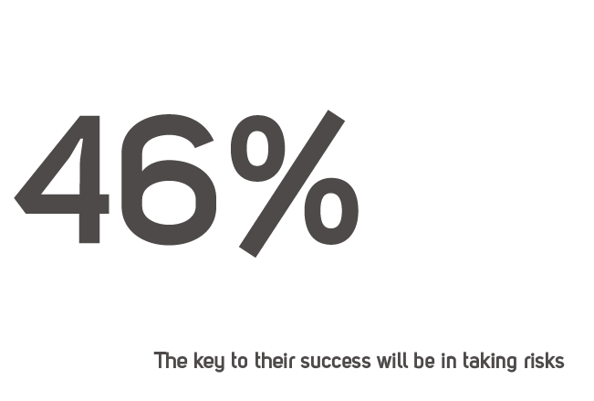

Slide 55
Risk Introduction
Risk Defined:
The possibility of an event occurring that will have an impact on the achievement of objectives. Risk is measured in terms of impact and likelihood. (IIA)
How does your department assess risks?

Slide 56
Activity: General Risks and Social Media
For each risk category listed, identify a specific risk to achievement of the organization’s objectives as it might apply to social media.

Slide 57
Specific Risks Related to Social Media
The #1 risk is to your brand
Other specific risks include:
Governance
Strategic
Regulatory
Operational
People
Other General Risks

Slide 58
Unit 7 The Social Media Audit

Slide 59
Risk - Strategy
Lack of a formal or an inadequate social media strategy could result in poor alignment with organizational strategies, invalid assessments of the strategies success, and inappropriate communication related to the organization’s initiatives
Objective of Audit - Strategy
To determine whether a social media strategy has been developed that is complete, aligned with other corporate strategies, and appropriately documented and communicated

Slide 60
Considerations - Strategy
Lack of Strategy
“This looks cool. Somebody do something.
No plans, no concepts, no leadership
Pseudo-Strategies
Ignoring social media – dismiss without deliberation
Non-participation = non-involvement
Inadequate Strategies
“Strategy” developed without basic understanding
False sense of security

Slide 61
Evaluation of Controls - Strategy
Expected controls:
Strategy document
Communication process
Meeting documentation
Approvals

Slide 62
Testing of Controls - Strategy
Match organizational strategies to social media strategies to verify alignment
Review strategy to verify it includes basic requirements
Strategic, not tactical, level
All stakeholders considered (not just Marketing, etc.)
Identify target audience, desired relationship, and desired conversational engagement
Identify social media channels
Properly identifies necessary resources

Slide 63
Testing of Controls - Strategy
Review business strategies to ensure social media initiatives are included
Review necessary documentation to ensure appropriate approvals were obtained

Slide 64
Risk – Governance & Oversight
Lack of appropriate governance and oversight related to social media initiatives could result in poorly aligned goals, mixed messaging to customers, inadequate interdepartmental communication, and a lack of direction related to social media initiatives.
Objective of Audit –Governance & Compliance
To determine whether effective oversight has been established for the use of all social media, including social media specifically developed by the organization.

Slide 65
Considerations – Governance & Oversight
No Group Responsible
Starts everywhere at once
No single “champion”
Missed Risks and Rewards
Misunderstand underlying risks
Focus on controls and risk versus opportunities
“Wrong” Group in Charge
No wrong group, but…
Examples – Risk, Compliance, Legal, IT

Slide 66
Evaluation of Controls – Governance & Oversight
Expected controls
Communication process
Board of Directors Meeting Documentation
Social Media Committee Documentation - Charter, Purpose, Objectives
Assurance Partners’ Reviews

Slide 67
Testing of Controls – Governance & Oversight
Review meeting minutes to verify appropriate involvement at board level
Review documented discussions to verify appropriate involvement of executive management
Analyze training completed at the board and executive management level to ensure all necessary parties understand the full impact of social media
Review Social Media Committee documentation to ensure it is providing direction to the appropriate committees
Ensure the charter, purpose, and objectives for the Social Media Committee has been appropriately reviewed and approved

Slide 68
Testing of Controls – Governance & Oversight
Review documentation on standing committee members to verify the make up of the committee is appropriate
Conduct a survey for all social media activities and verify this matches similar surveys conducted by the committee
Determine if appropriate reviews have been conducted by assurance providers
Identify other related committees and initiatives and verify coordination with the social media committee
Conduct a survey of employees to determine their involvement in social media

Slide 69
Risk – Planning
Inadequate planning for social media initiatives may result in delayed implementation, inadequate measures of success, and wasted resources.
Objective of Audit - Planning
To determine whether the organization’s planning related to social media is complete, in alignment with the related strategies, and appropriately communicated

Slide 70
Evaluation of Controls – Planning
Expected controls
Articulated Strategy and Plan - Organization
Articulated Strategy and Plan - Department
Social Media Committee Documentation - Charter, Purpose, Objectives
Approval of Goals
Approval of Vendor Contracts

Slide 71
Testing of Controls – Planning
Review social media plans for completeness including:
Specific, measurable, achievable, relevant, and time bound
Social media channels
Stakeholder engagement – style, frequency, consistency
Departments responsible
Limitations (e.g. restricted channels, resource constraints)
Resource allotments

Slide 72
Testing of Controls – Planning
Compare social media plans to organizational plans to ensure alignment
Identify all vendors used in social media initiatives and ensure:
Contracts match organizational guidelines
Appropriate SLAs have been established
Clear measures of success and deliverables are defined
Review QA work done related to outside vendors. Re-perform this work to ensure the accuracy of the process

Slide 73
Testing of Controls – Planning
Compare goals with the current state of the project to ensure timely completion.
If delays have been identified, review the actions taken to verify appropriate elevation of these issues
Analyze expenses to identify vendors who may be working on social media.

Slide 74
Risk – Execution
Inadequate or improperly designed policies and procedures can result in haphazard approaches, misaligned activities, poor direction, and ultimate failure of processes supporting social media.
Objective of Audit - Execution
To determine whether appropriate policies and procedures have been implemented to ensure the successful execution of the social media plan.

Slide 75
Evaluation of Controls – Execution
Expected controls
Policies and procedures
Organizational design
Approval of policies and procedures
Quality assurance reviews

Slide 76
Testing of Controls – Execution
Review organizational charts to ensure appropriate reporting relationships and oversight within the department(s)
Review job descriptions for those working in social media to ensure they properly reflect the work being done
Review correspondence and communication to ensure all departments involved with social media have been provided the strategy, direction, and plans
Verify appropriate metrics have been established related to execution of the social media plan
Review performance plans of employees to verify plans are in alignment with social media goals and objectives

Slide 77
Risk – Metrics
Inadequate or improper metrics related to social media operations can result in a focus on the wrong activities, an inability to determine success, and improper reporting of overall results.
Objective of Audit - Metrics
To determine whether metrics have been established to ensure successful implementation and use of social media.

Slide 78
Considerations - Metrics
No Metrics
With no measures, how do you determine success
Misaligned with Organizational Goals
Is everyone measuring the same thing
Poor Metrics
What is a poor metric?

Slide 79
What is a Poor Metric?
Website hits
Blog Comments
Facebook Friends
Twitter Followers

Slide 80
Good Metrics?
Depends on what you are trying to do
Brand Recognition
Advocate Numbers and Frequency
Customer Service
Issue Resolution Rate
Sales & Marketing
Sales Generated
Human Resources
Potential Candidate Engagement

Slide 81
Evaluation of Controls – Metrics
Expected controls
Approval of Metrics
Policies and Procedures
Periodic status reports
Defined actions from results

Slide 82
Testing of Controls – Metrics
Verify that metrics have been established
Review metrics to ensure the following
Measurable
Align with Strategies/Goals/Objectives (both for the organization and social media)
Are “value-add” measures
Acceptable ranges defined
Verify that responsibility for gathering metrics has been established, including appropriate reporting of results

Slide 83
Testing of Controls – Metrics
Review metric reports to verify the accuracy of reporting
If metrics are falling outside the acceptable ranges, verify appropriate actions have been taken
Review oversight committee documentation to ensure that reporting to these groups matches the actual results of reviews

Slide 84
Risk – Monitoring
Poor monitoring can result in missed issues and opportunities, poor customer service, and a negative impact on the brand.
Objective of Audit - Monitoring
To determine whether appropriate monitoring systems have been established over communications related to social media.

Slide 85
Considerations - Monitoring
Who is Watching?
How Often are they Watching?
Are they Watching Everything?
What do they Do With What they Watch?

Slide 86
Evaluation of Controls – Monitoring
Expected controls
Policies and Procedures
Periodic Reporting
Issue Escalation Process (Triage)

Slide 87
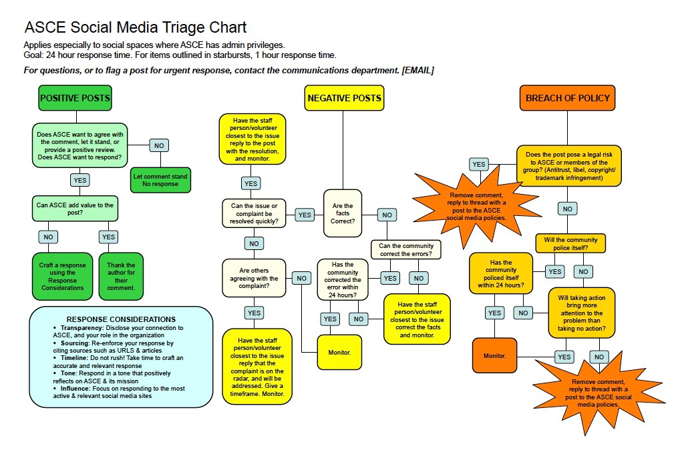
Social Media Triage

Slide 88
Testing of Controls – Monitoring
Review policies and procedures to ensure appropriate monitoring and reporting has been established
Verify keywords, hot topics, and restricted issues have been identified for monitoring
Discuss triage procedures with employees to ensure an understanding of how they are used
Review previous reports and actions taken to ensure compliance with triage procedures
Monitor current and past activities on social media to identify potential issues and verify appropriate actions were taken

Slide 89
Risk – Regulatory & Compliance
Poor evaluation of regulatory and compliance issues related to social media can result in fines and penalties, as well as damage to the organization’s reputation.
Objective of Audit – Regulatory & Compliance
To determine whether the organization’s actions related to social media comply with all applicable federal and local regulatory issues.

Slide 90
Evaluation of Controls – Regulatory and Compliance
Expected controls
Review of Laws and Regulations
Communication of Review Results
Tests of Compliance

Slide 91
Testing of Controls – Regulatory & Compliance
Review pertinent regulations to determine if they were identified by the organization
If regulations have been identified, verify that these were appropriately communicated and necessary actions taken
Review risk assessments to ensure social media has been included
Verify that, if social media issues are identified during risk assessment, the results have been appropriately elevated

Slide 92
IT Risks
Viruses and Malware
Data leakage/theft
Brand Hijacking
Customer gets exposed to hijacked and fraudulent presence
Lack of Control Over Corporate Content
Employee posting wrong or improper content
Unrealistic Customer Service Expectations
Service at the speed of the internet
Mismanagement of Communications
Impact of retention regulations or e-discovery
Per ISACA White Paper

Slide 93
IT Risk Responses
Viruses and Malware
Antivirus and anti-malware controls installed
Brand Hijacking
“Find a firm to protect your brand. Update customers”
Lack of Control Over Corporate Content
Establish social media policies. Capture and log
Unrealistic Customer Service Expectations
Ensure staff can handle. Timeline for responses
Mismanagement of Communications
Establish policies and procedures
Per ISACA Workpaper

Slide 94
A Final (or First) Decision
Is this an audit,
or an advisory engagement?

Slide 95
Seven Findings for Free - #1
Governance
Are the results of social media activities being reported to the appropriate level?

Slide 96
Seven Findings for Free - #2
Strategy
If a strategy has been articulated, is there evidence it is aligned with the organization’s objectives

Slide 97
Seven Findings for Free - #3
Plan
Have SMART goals been established?

Slide 98
Seven Findings for Free - #4
Execution
Have roles and responsibilities been defined for all individuals involved in social media projects?

Slide 99
Seven Findings for Free - #5
Metrics
Do metrics align to the organizational goals?

Slide 100
Seven Findings for Free - #6
Monitoring
Do procedures exist to escalate identified issues?

Slide 101
Seven Findings for Free - #7
Training
Have all employees been trained on the organization’s social media policy?

Slide 102
Unit 8 Seminar Conclusion

Slide 103
Putting it All Together
Seminar Objectives Revisited:
Develop an understanding what is meant by social media, the full spectrum of opportunities, and how companies use this new tool
Develop an understanding of what makes up good social media strategies, governance, and policies.
Identify the risks in various aspects of social media
Design the basic steps of a review over an organization’s social media

Slide 104
Any Questions?
Contact us
Peter Scott
prscott@prscott.com
Mike Jacka
figre@cox.net

Slide 105
Wrap-Up
Thank you for your participation!

